Slide 1
AWS Solutions Architect Certification Live Training Program
Pranjal Srivastava

Slide 2
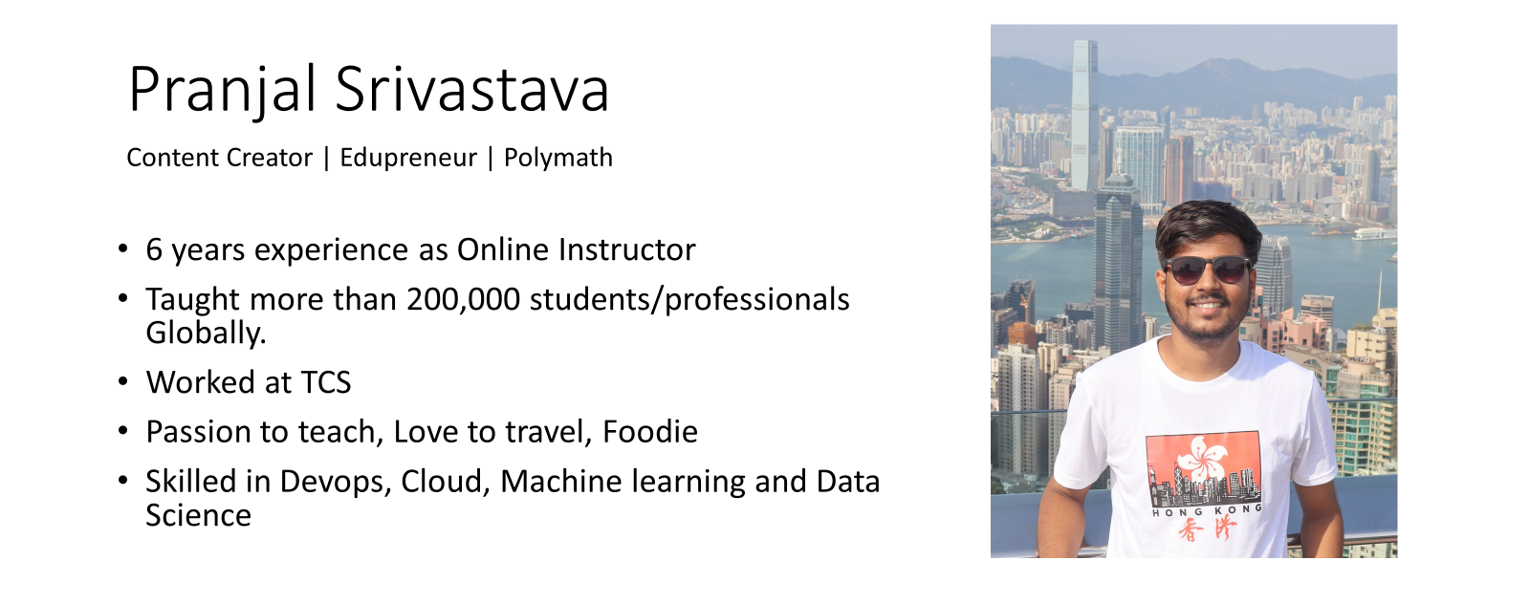
https://www.linkedin.com/in/srivastavapranjal/
https://github.com/iampsrv

Slide 3
Target Audience
Candidates with at least 1 year of hands-on experience designing cloud solutions using AWS services.

Slide 4
Exam Format
Multiple choice and multiple response questions.
65 questions to be completed in 130 minutes.
Unanswered questions are scored as incorrect
No penalty for guessing.
Out of 65 questions, 50 questions in exam that affect the score.
The exam uses a scaled score model (100–1,000), with a minimum passing score of 720.

Slide 5
Cost
Exam Fee: The exam costs $150 USD.
Practice Exam: An optional practice exam is available for $20 USD.

Slide 6
Certification Validity and Renewal
Validity: The certification is valid for three years.
Recertification: To maintain your certification, you must either pass the latest version of the associate exam or a higher-level professional exam before your certification expires.

Slide 7
4 Exam Domains
Design Secure Architectures (30%)
Design Resilient Architectures (26%)
Design High-Performing Architectures (24%)
Design Cost-Optimized Architectures (20%)

Slide 8
Design Secure Architectures (30%)
Access controls, IAM, security best practices.
Secure application design and network configuration.
Data encryption, backup, and recovery strategies.

Slide 9
Design Resilient Architectures (26%)
Microservices, event-driven architectures, serverless technologies.
Disaster recovery (DR) strategies, high availability, and fault tolerance.

Slide 10
Design High-Performing Architectures (24%
Optimizing storage, compute, and database services for performance.
Scalable networking solutions and data processing architectures.

Slide 11
Design Cost-Optimized Architectures (20%)
Cost management tools and services (Cost Explorer, Budgets).
Cost-effective storage, compute, and database services.

